Slide 1
OWASP Portland Chapter
Welcome to OWASP Portland’s
monthly chapter meeting!

Slide 2
Twitter: @PortlandOWASP
Website: pdxowasp.org
Meetup: https://www.meetup.com/OWASP-Portland-Chapter/
Slack: owasp.slack.com #chapter-pdx

Slide 3
February Chapter Meeting
CMD+CTRL Web Application Cyber Range
Presented by: John L. Whiteman
Tuesday February 11, 2020 from 5:30–9pm
Hosted by: Zapproved 1414 NW Northrup St. #700, Portland
https://www.meetup.com/OWASP-Portland-Chapter/events/267265705

Slide 4
Introduction to burp suite
Ryan Krause Portland, ORegon owasp chapter meeting January 2020

Slide 5

Who am i?
11 years in the InfoSec field doing various things
Currently:
Managing Consultant at NetSPI
Web application and network penetration testing
Previously:
Security Engineering/AppSec at HP
Vulnerability Scanner Development & IT at BeyondTrust
Web Development at Comcast
Web Development & QA at Western Digital
Education
Computer Engineering, B.S. - UC Irvine (zot zot!)

Slide 6

Agenda
What’s Burp Suite?
Burp Suite editions
Installation and configuration
Introduction to Burp Suite’s core set of tools
Examples of the tools in action (against OWASP Juice Shop)
Q & A

Slide 7

Burp suite…What is it?
Web application penetration testing platform
Typically used to intercept and modify HTTP traffic between web browsers and web applications/servers
There are several tools within Burp Suite
Target
Proxy
Intruder
Repeater
Decoder
Comparer
Extender
Sequencer
Clickbandit
Collaborator
Mobile Assistant

Slide 8
Burp suite…What is it?
Web application penetration testing platform
Typically used to intercept and modify HTTP traffic between web browsers and web applications/servers
There are several tools within Burp Suite
Target
Proxy
Intruder
Repeater
Decoder
Comparer
Extender
Sequencer
Clickbandit
Collaborator
Mobile Assistant

Slide 9
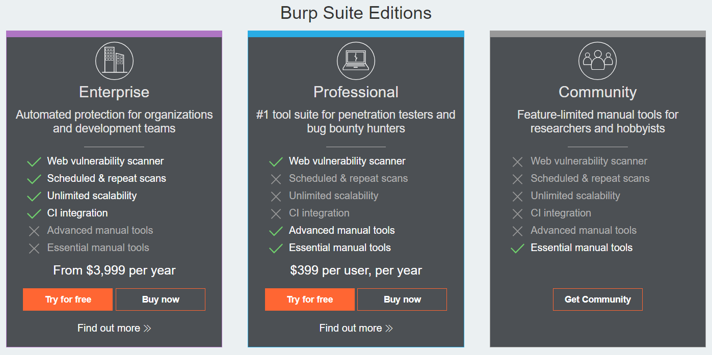
Burp Suite Editions

Slide 10

Burp suite installation
Written in Java - runs on Windows, Mac, Linux, etc.
Burp Community Edition Download: https://portswigger.net/burp/communitydownload
Alternatively, Burp comes pre-installed on Kali Linux, which can be run in a VM using VirtualBox, VMWare Player, or Hyper-V
https://www.offensive-security.com/kali-linux-vm-vmware-virtualbox-image-download/
https://www.virtualbox.org/
https://my.vmware.com/en/web/vmware/free#desktop_end_user_computing/vmware_workstation_player/15_0

Slide 11

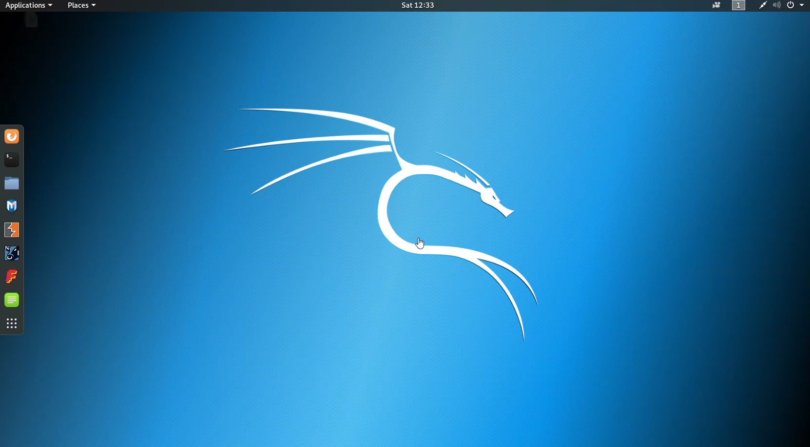
Burp suite Configuration
Two main steps to get Burp running after it’s installed:
Configure your browser’s proxy settings to work with Burp
Install Burp’s CA certificate in your browser (used for HTTPS-based sites)

Slide 12
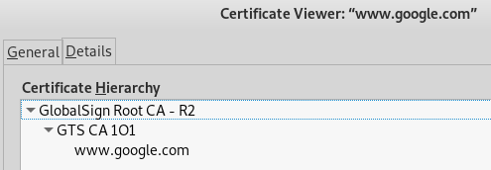
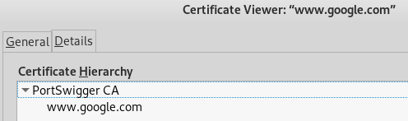
Burp suite Configuration
The CA certificate installation is necessary so Burp can man-in-the-middle the encrypted traffic between the browser and server for HTTPS connections
Ex: https://www.google.com No Burp Proxy: Burp Proxy - Burp CA installed:

Slide 13
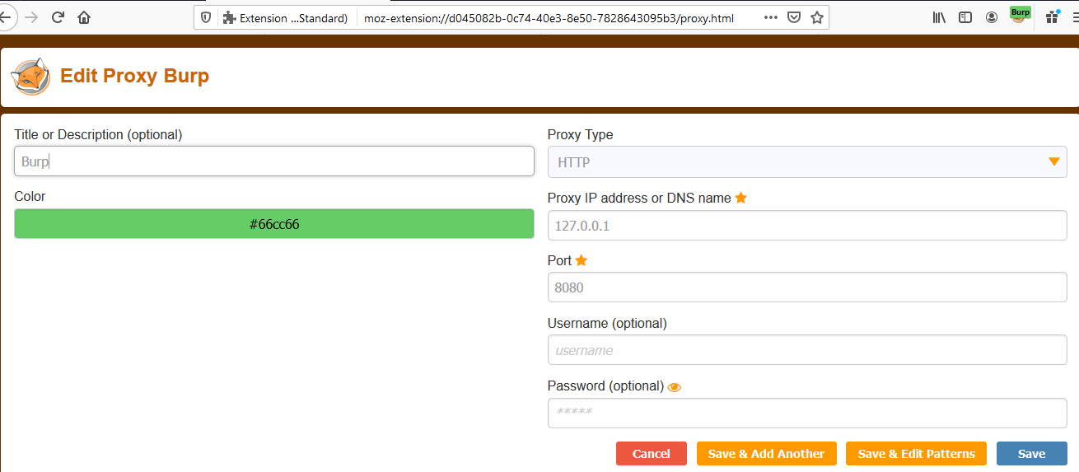
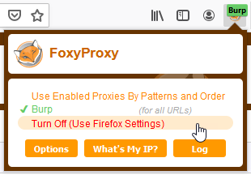
Burp suite Configuration
Install the FoxyProxy Firefox plugin to easily turn Burp proxy config on/off

Slide 14

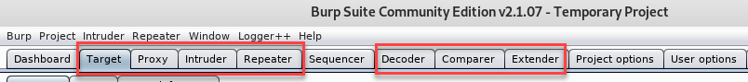
Burp’s core tools
Target
Proxy
Intruder
Repeater
Decoder
Comparer
Extender

Slide 15
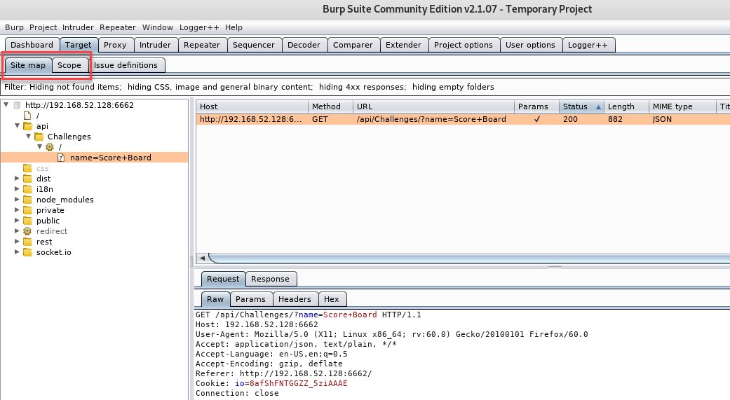
Burp’s core tools - target
Contains the Site map and Scope information

Slide 16
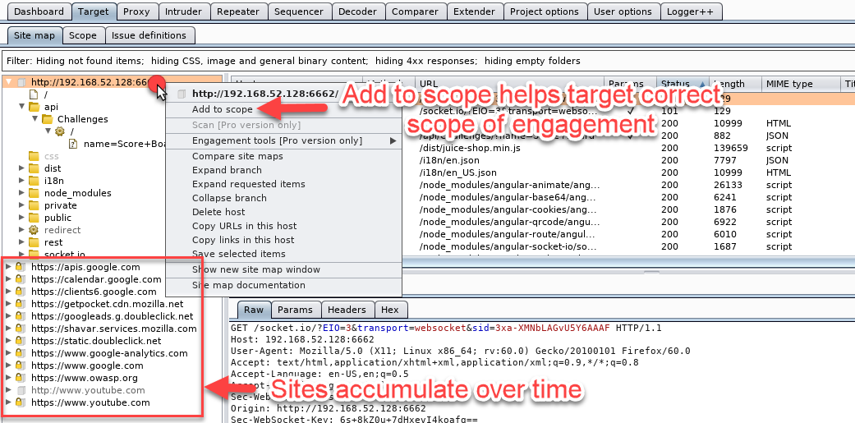
Main purpose is to help define the proper scope for the test

Slide 17
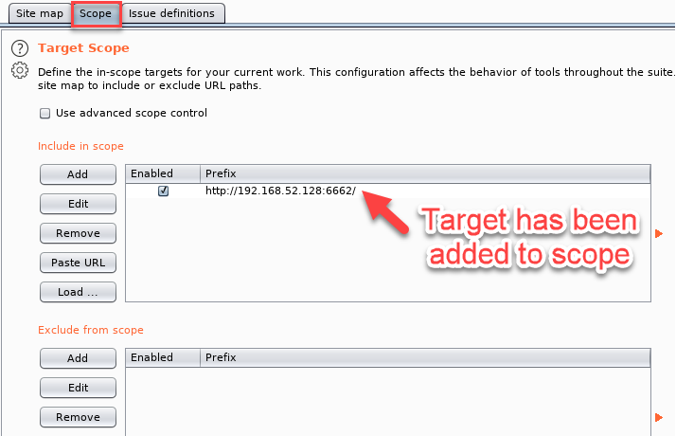
When you “Add to scope,” Burp adds the target to the Scope tab

Slide 18
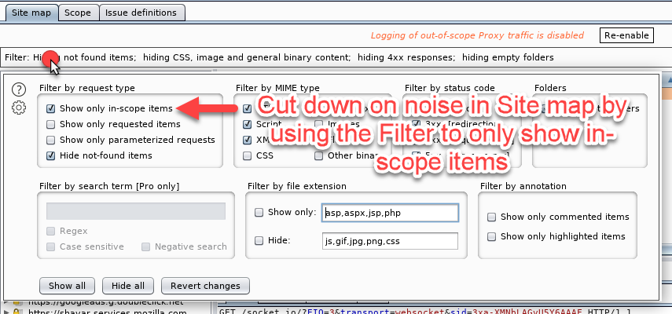
Filters can help keep your Site map focused

Slide 19
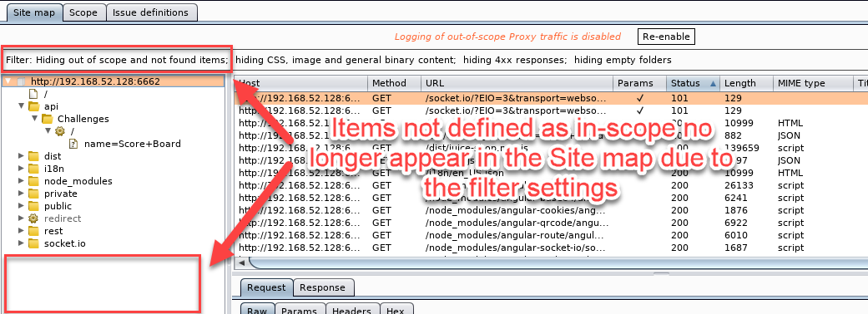
A clean Site map helps ensure you’re testing the correct targets

Slide 20
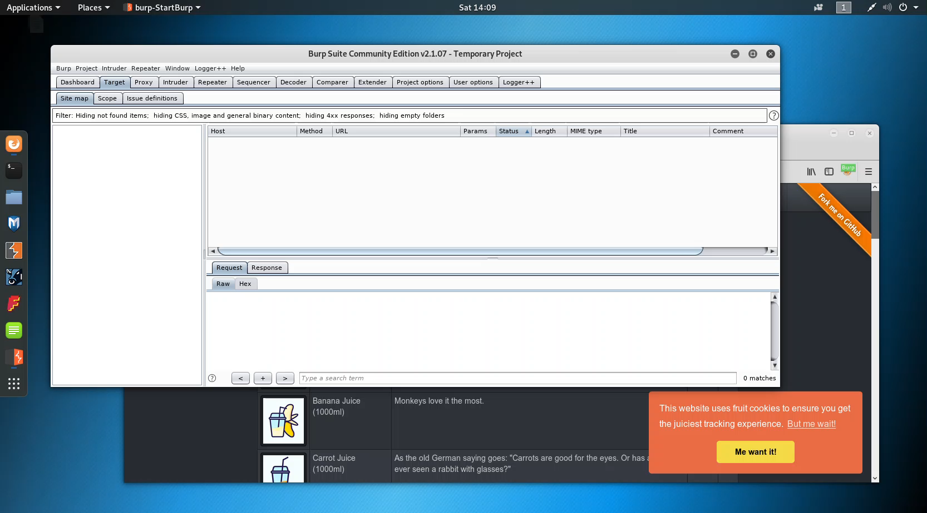
Burp’s core tools - target
Defining scope is useful because:
Ensures that we’re staying in-scope during testing
http://clientsite.com vs http://clientsites.com
When scope is defined in the Target Site map, it also applies to other tools in the suite (Proxy, etc.)

Slide 21
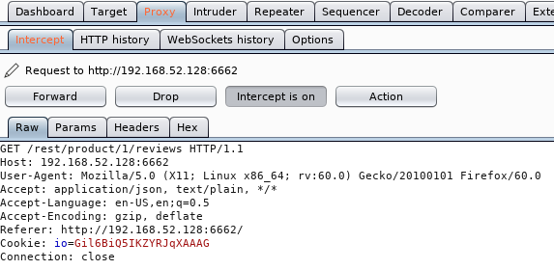
Burp’s core tools - Proxy
Burp’s main user-driven testing workhorse
Used for intercepting and modifying HTTP requests/responses

Slide 22
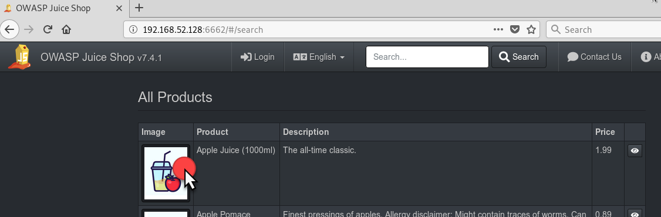
Turn on Intercept in Burp’s Proxy
To see Intercept in action, click on a link in the application

Slide 23
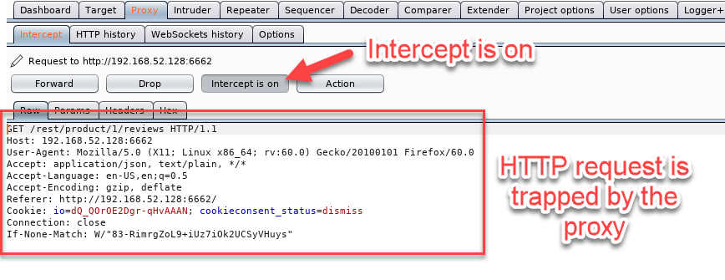
The proxy intercepts the request, which can be:
Inspected
Modified
Forwarded to another tool like Intruder, Repeater, Comparer, etc.

Slide 24
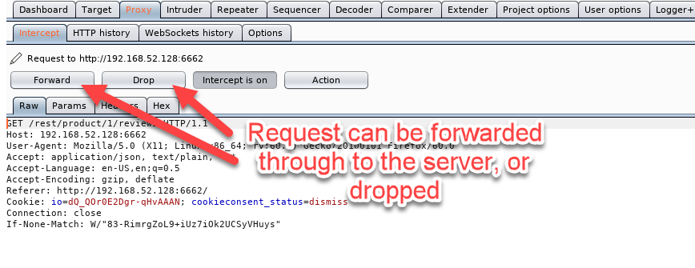
Forward – Pass request to server
Drop – Discard request (not sent to server)

Slide 25
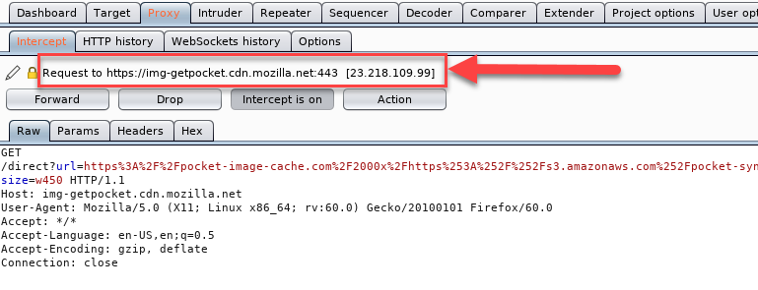
Out-of-scope requests flow through proxy too
Makes it harder to track target application flow
Remember when I said defining scope was helpful in the Site Map…?

Slide 26
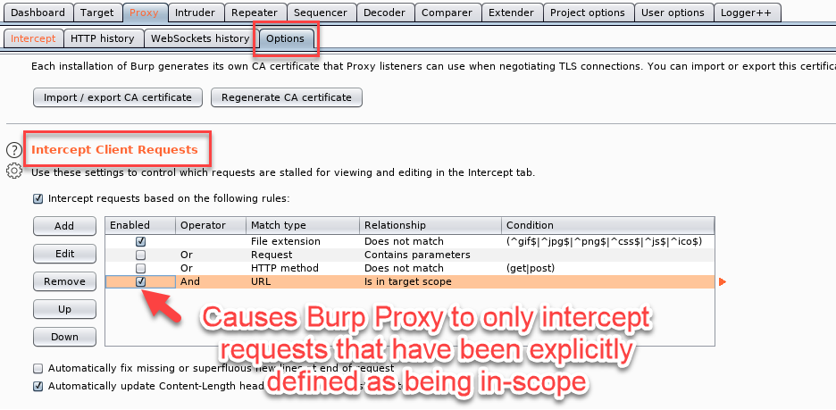
Set this option to only intercept requests to in-scope targets

Slide 27
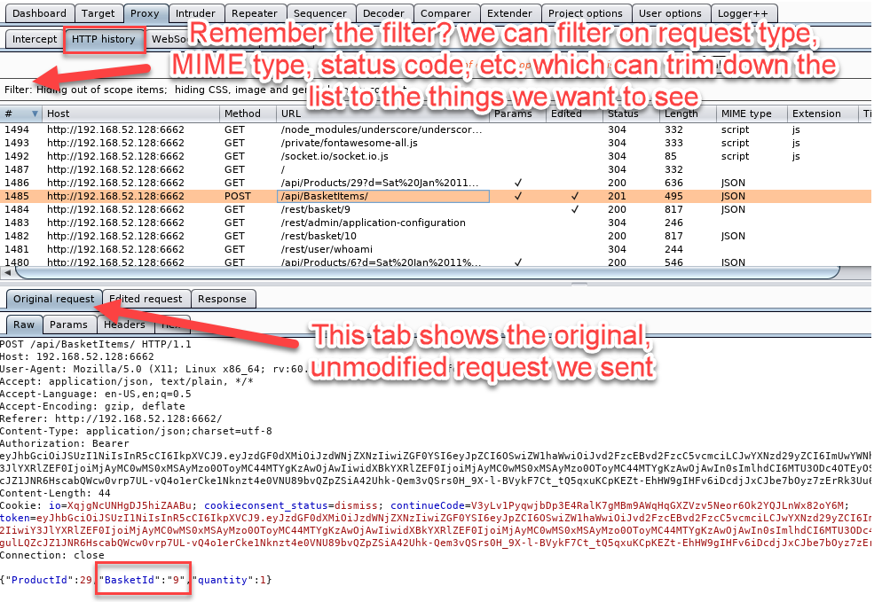
Other Proxy features: HTTP history tab saves all proxied traffic

Slide 28
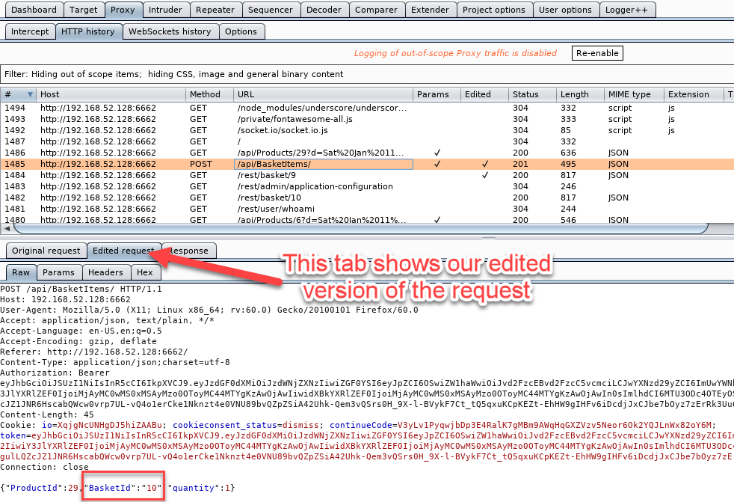
Other Proxy features: HTTP history tab saves all proxied traffic

Slide 29
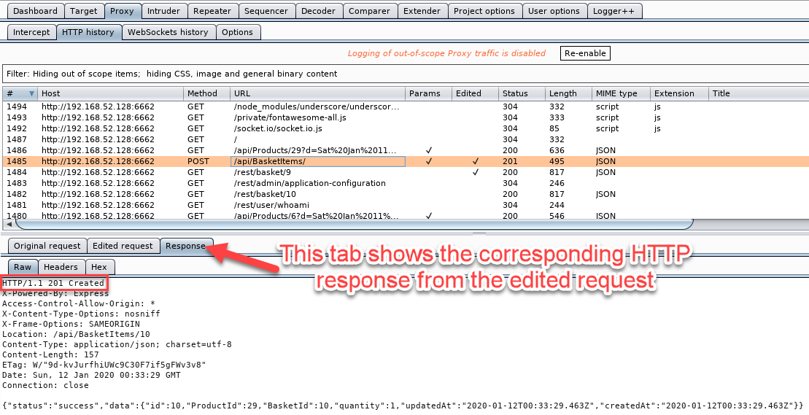
Other Proxy features: HTTP history tab saves all proxied traffic

Slide 30
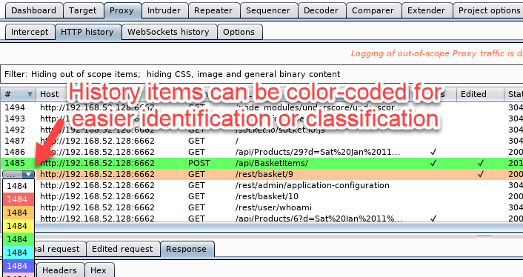
Other Proxy features: HTTP history tab can color-code entries

Slide 31
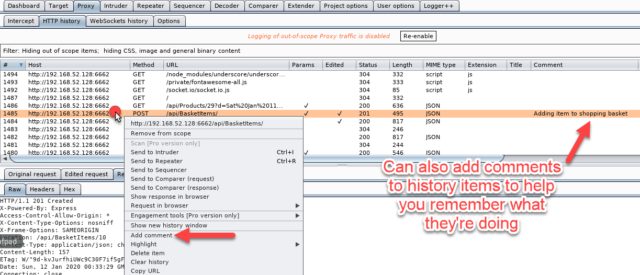
Other Proxy features: HTTP history tab allows comments on entries

Slide 32
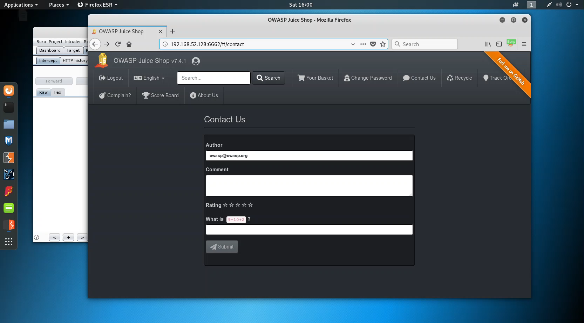
Burp’s core tools - Proxy
How does the ability to intercept requests with the proxy help us find web vulnerabilities?
Example: Client-side Controls Bypass
JavaScript is enforcing the requirement that at least one star must be selected in the Contact Us form before the Submit button is activated

Slide 33
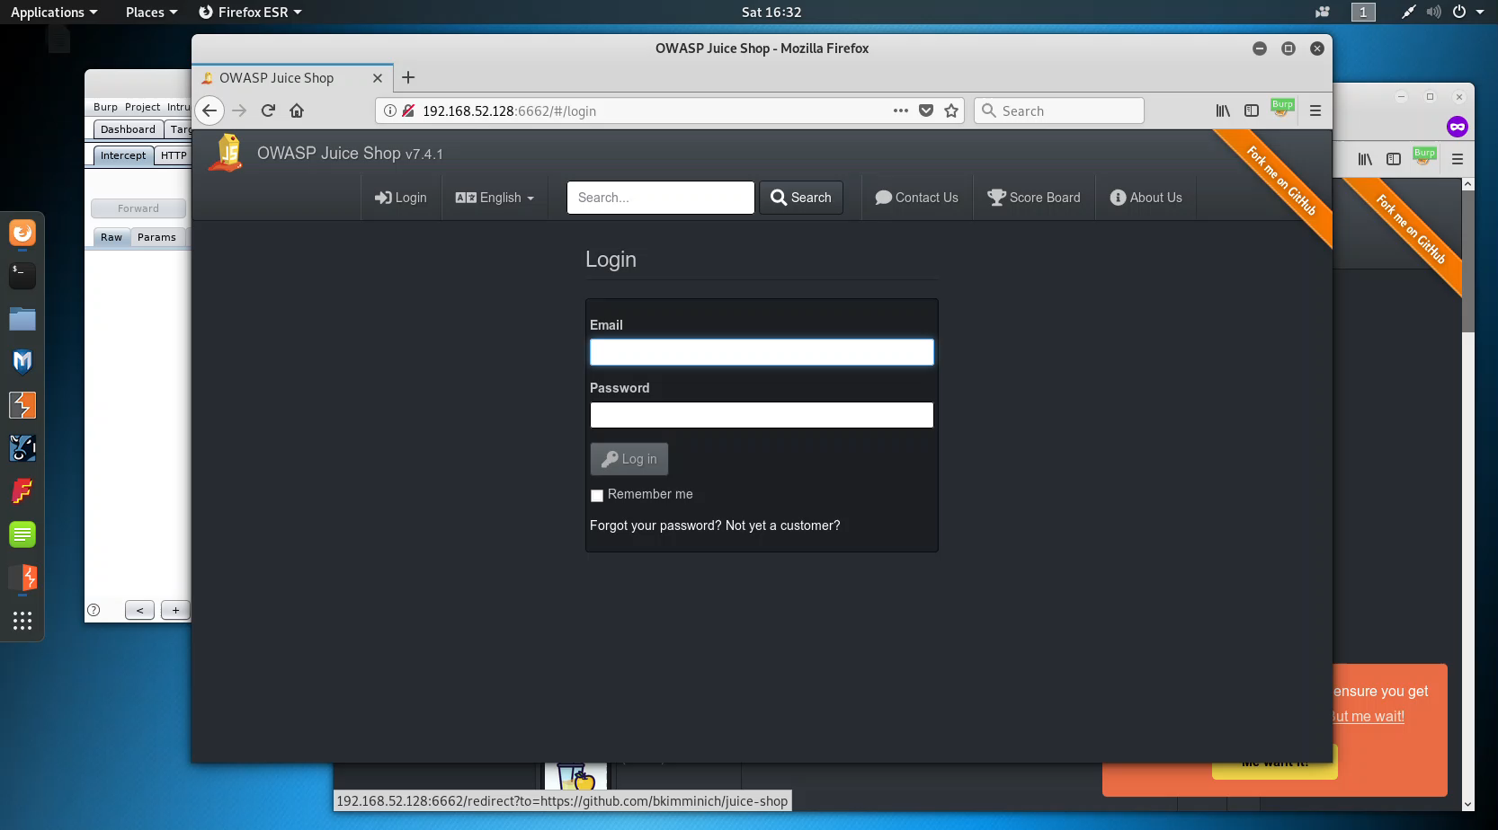
Burp’s core tools - Proxy
How does the ability to intercept requests with the proxy help us find web vulnerabilities?
Example: Authorization Bypass
A user can modify the shopping basket ID in an HTTP request in order to add products to another user’s shopping basket

Slide 34
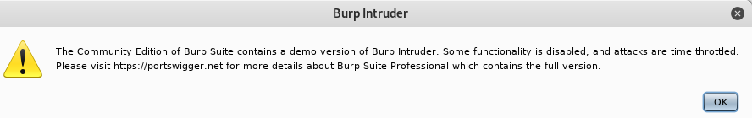
Burp’s core tools - Intruder
Used for automating attacks against a web app
Can be used to fuzz inputs, submit forms with different payloads, etc.
Intruder is handcuffed in Burp Suite Community edition by limited functionality and throttling
Still works well enough to use for testing

Slide 35
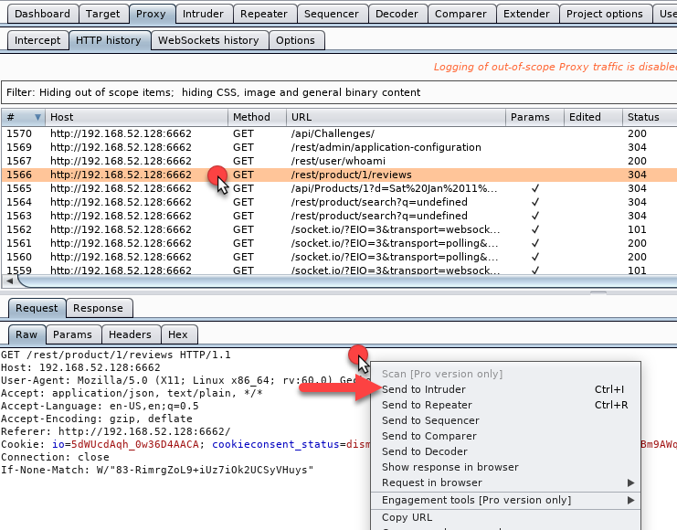
To start an Intruder attack, select an HTTP history request and “Send to Intruder”

Slide 36
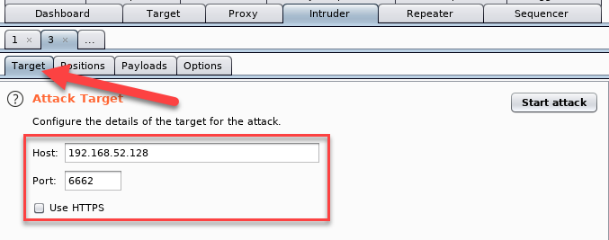
Target tab defines host, port, and protocol to attack

Slide 37
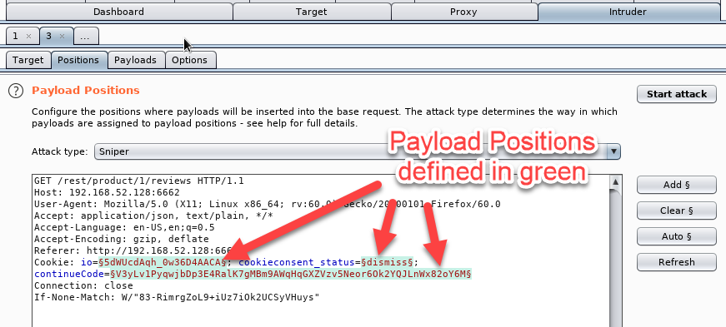
Positions tab specifies the attack type and where the payloads should be inserted in the request
Positions are defined in green
To Add, highlight a selection of text and click “Add”
Clear clears all positions
Auto will try to automatically highlight available insertion points

Slide 38
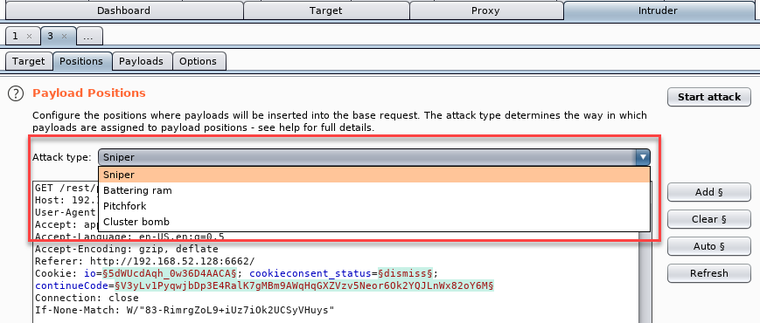
Attack type specifies how the payloads are applied
Four different attack types: Sniper, Battering ram, Pitchfork, Cluster bomb

Slide 39
Single payload set:
Sniper: payload is applied to each position individually, one request at a time
Battering ram: payload is applied to all positions at once
Multiple payload sets:
Pitchfork: each position gets its own payload set
Request #1 = Set A/Item 1, Set B/Item 1
Request #2 = Set A/Item 2, Set B/Item 2
Cluster bomb: each position gets its own payload set
Request #1 = Set A/Item 1, Set B Item 1
Request #2 = Set A/Item 2, Set B Item 1
…
Request #X = Set A/Item 1, Set B Item 1
Request #Y = Set A/Item 1, Set B Item 2
…
Tests all permutations of input for all lists….lots of requests

Slide 40
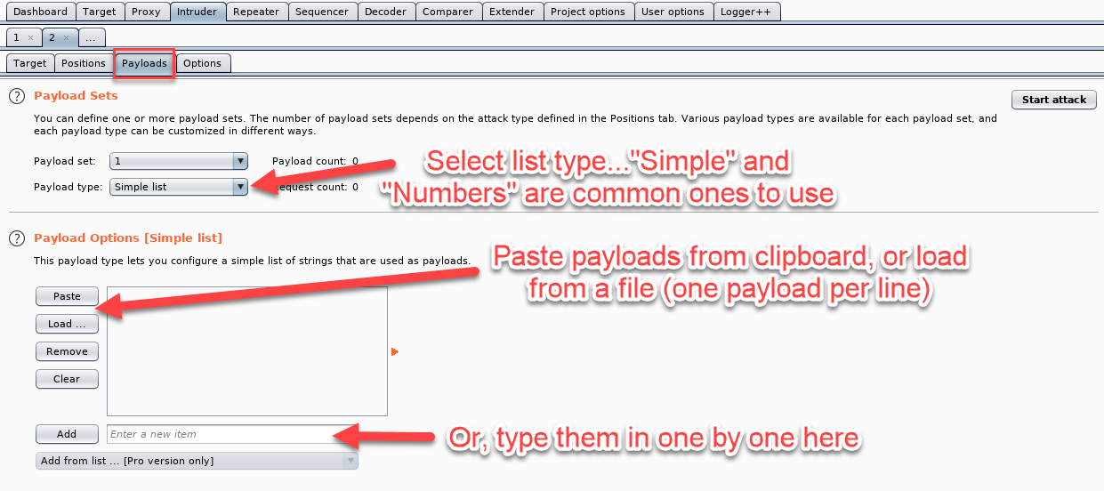
Payloads tab specifies the type of payloads that will be inserted into the positions defined in the Positions tab
Lots of payload types, but “Simple list” and “Numbers” are common

Slide 41
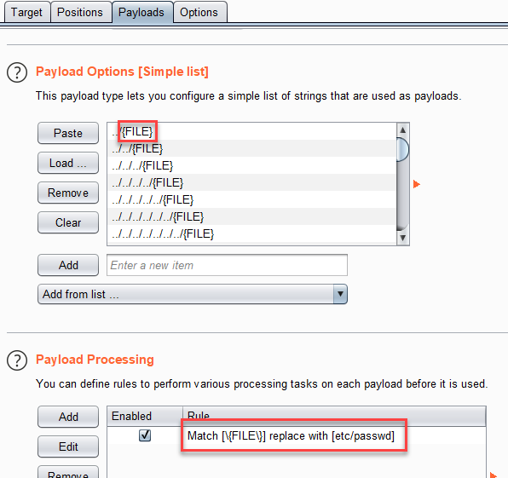
Processing rules can be defined to alter the payloads before they’re sent
Ex: file path traversal fuzzing to look for a specific file (/etc/passwd)

Slide 42
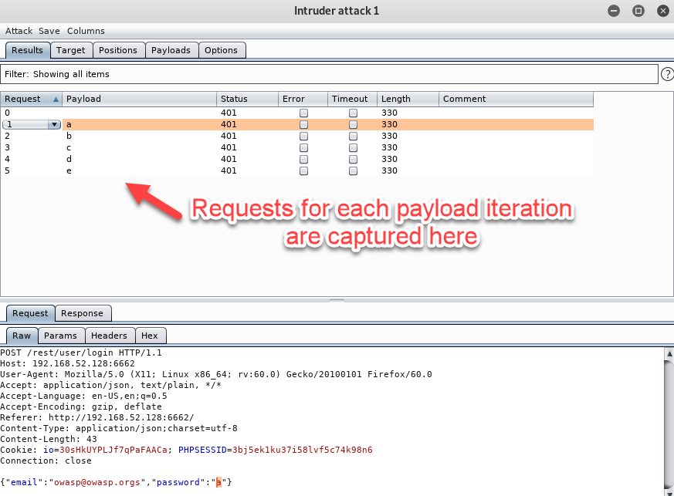
Requests are logged in a new window when attack is launched
Request and response are showed for each payload sent

Slide 43
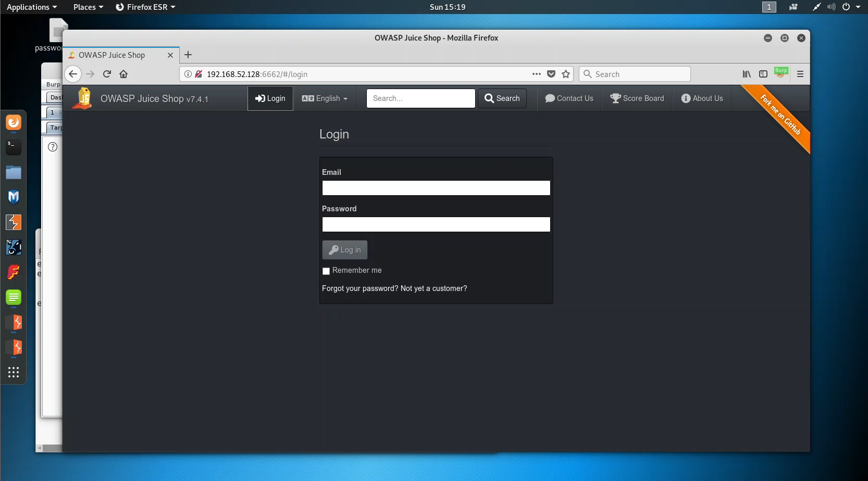
Burp’s core tools - intruder
How does the ability to automate requests with different attack payloads help us find web vulnerabilities?
Example: Login Brute Forcing
A username is obtained through OSINT, but we’re unsure of the password. We know this app does not have a user lockout feature. We can use Intruder to brute force the user’s password.

Slide 44
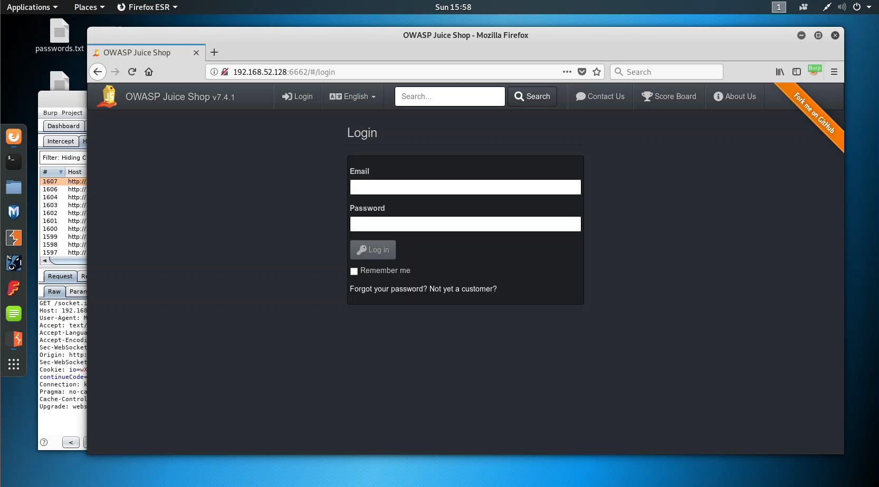
Burp’s core tools - intruder
How does the ability to automate requests with different attack payloads help us find web vulnerabilities?
Example: Authentication Bypass Using SQL Injection
Login forms are common places to find SQL injection flaws that can lead to authentication bypasses. Intruder can help us fuzz the form inputs with various SQLi payloads to see if it’s vulnerable.

Slide 45
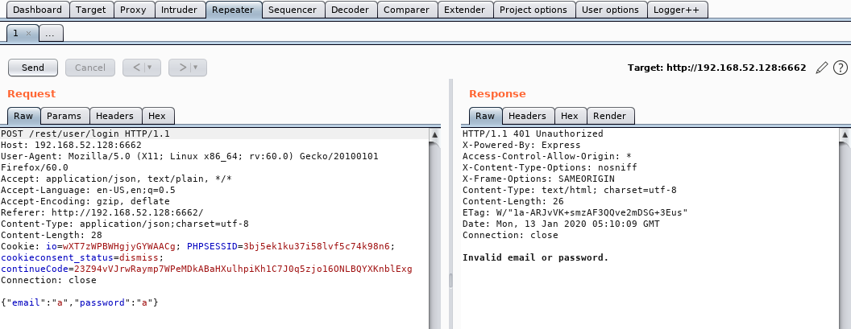
Burp’s core tools - repeater
Used for manually tampering with and replaying requests to the server to see how it responds to your changes

Slide 46
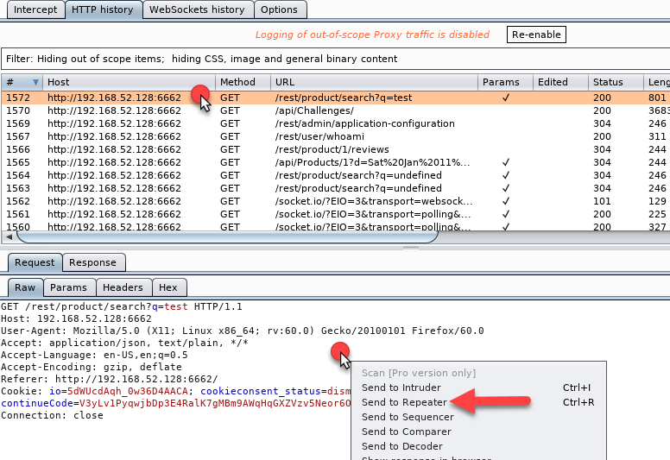
Common task is to send an item from HTTP history or Intercept to Repeater:

Slide 47
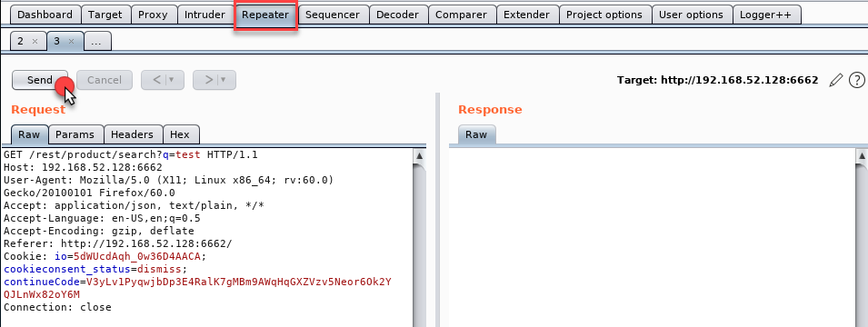
Click the Send button to submit the request to the specified target:

Slide 48
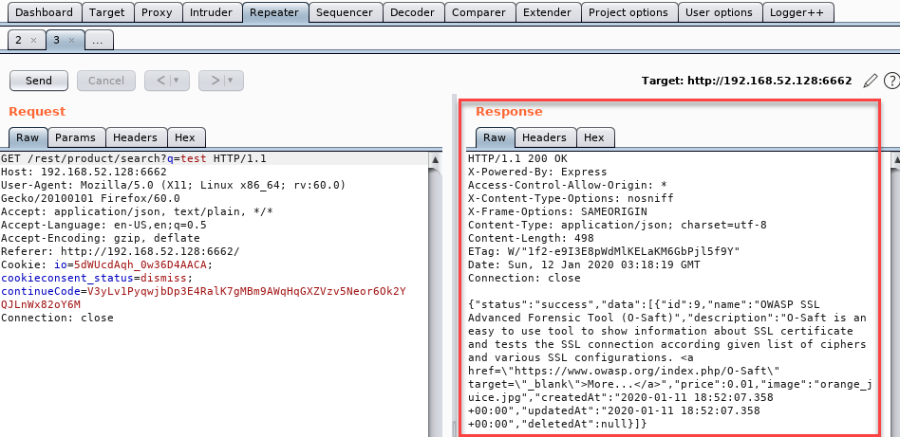
The response is displayed on the right

Slide 49
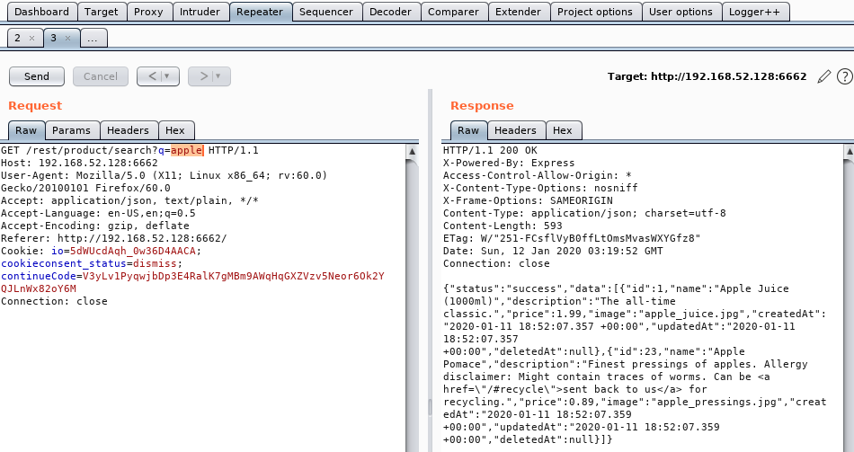
Modify parameter values, headers, cookies, etc. to see how the response changes
Ex: query string value was changed and different search results were returned

Slide 50
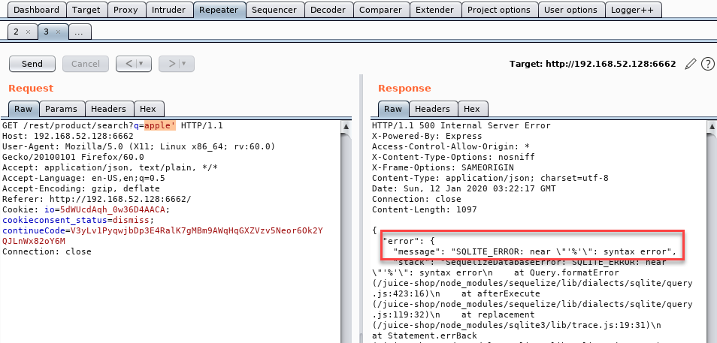
Helpful for discovering issues via manual testing
Ex: a single quote was added to the end of the search query value and the response contained a SQLITE error message…SQL injection?

Slide 51
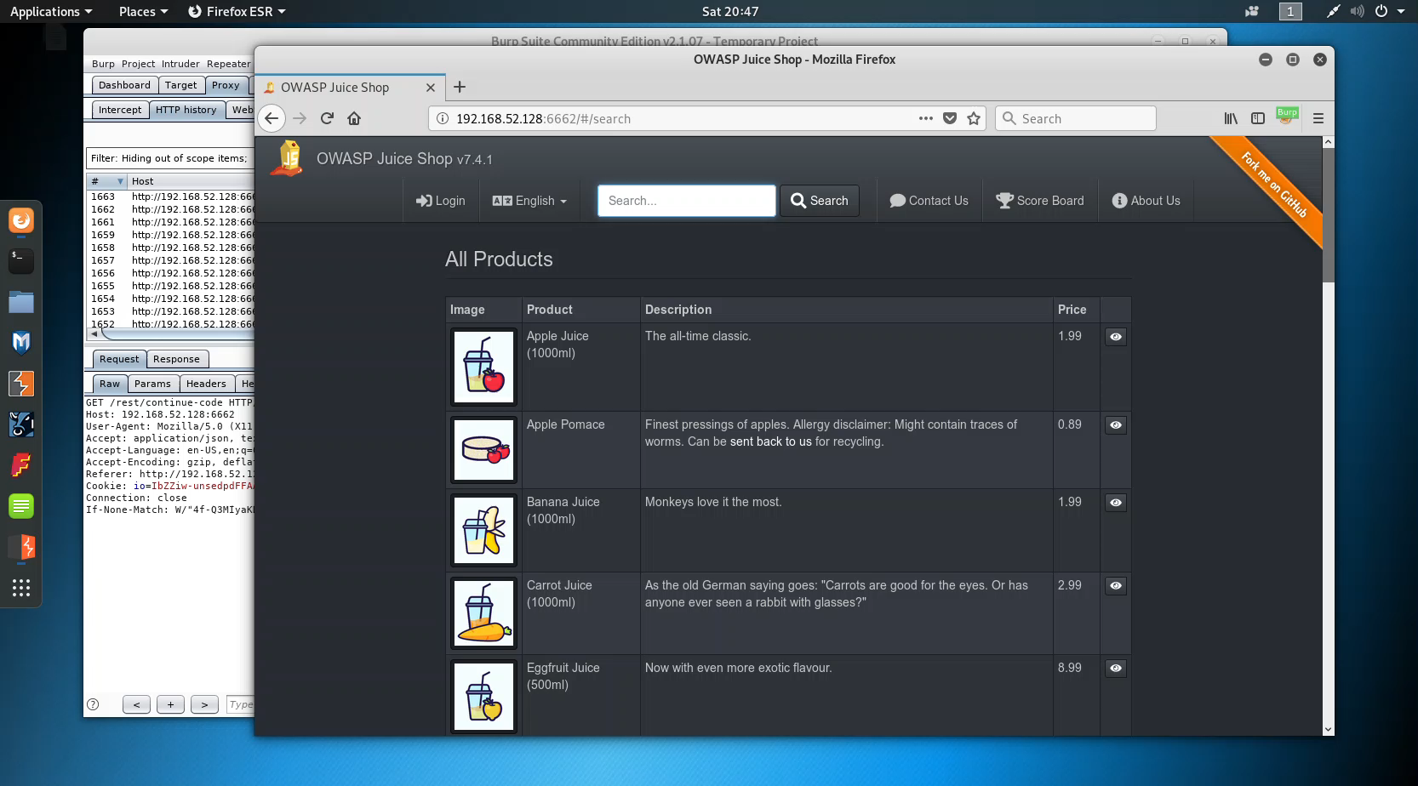
Burp’s core tools - REPEATER
How does the ability to repeat manipulated requests help us find web vulnerabilities?
Example: SQL Injection
A user can search for products using the search bar at the top of app. The search function is vulnerable to SQLi, but the right query needs to be crafted to exploit it.

Slide 52
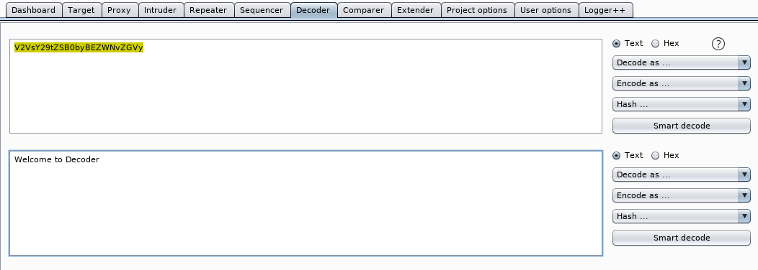
Burp’s core tools - decoder
Decoder transforms raw data into various encoded and hashed forms
It can analyze the data and automatically detect the encoding type

Slide 53
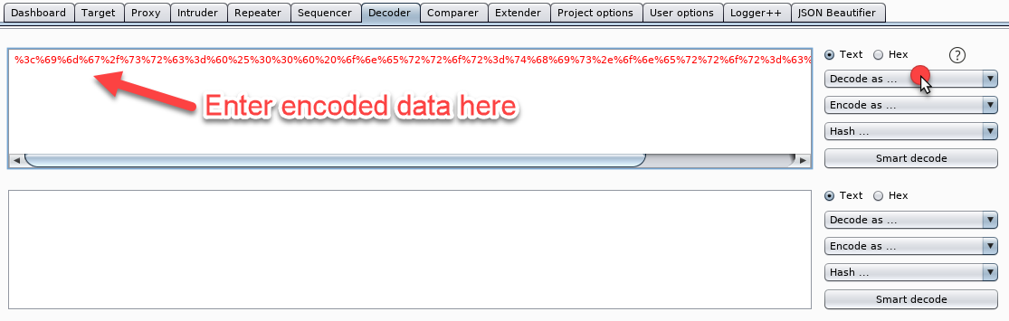
Encoded data can be entered into the editor panel and decoded into various formats:
URL
HTML
Base64
ASCII Hex
Hex
Octal
Binary
GZip

Slide 54
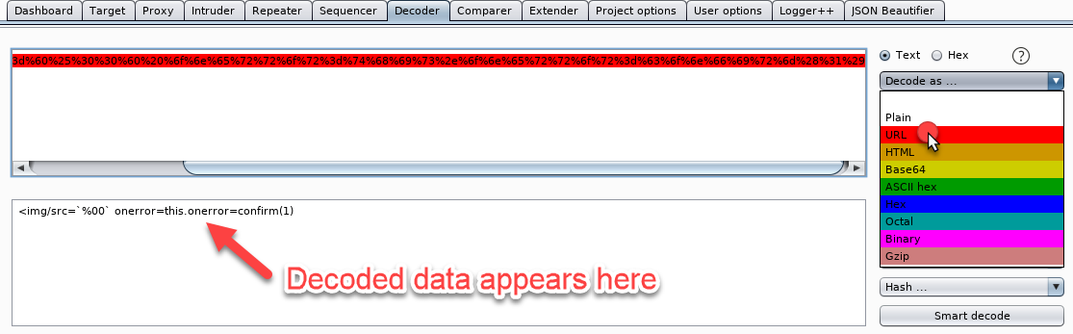
Ex: data is decoded using URL-decoding and results in an XSS payload

Slide 55
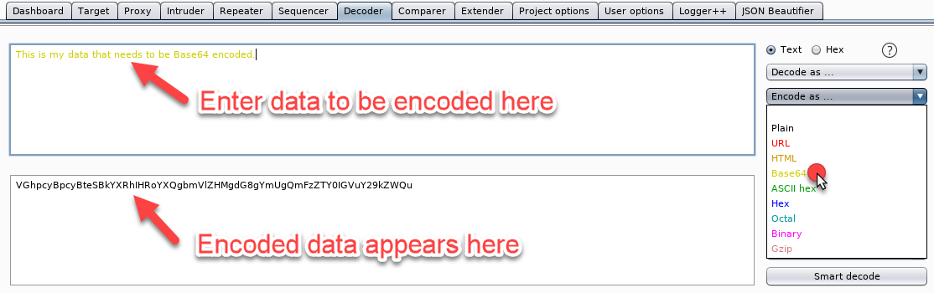
Encoding works the same way
Ex: data from the top editor panel is encoded in the lower editor panel

Slide 56
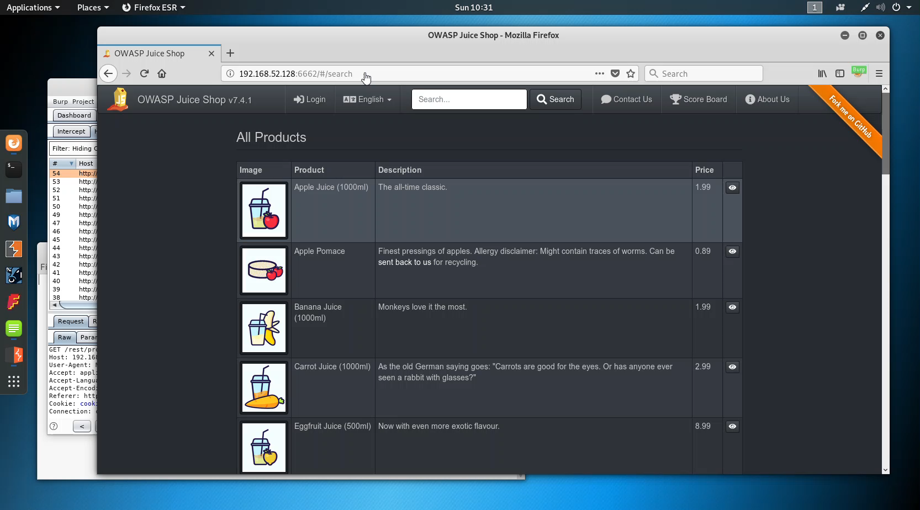
Burp’s core tools - DECODER
How does the ability to encode or decode data help us find web vulnerabilities?
Example: JWT Token Forgery
A user can decode a JWT token, remove the encryption and signature information, modify user information, then re-encode it to impersonate that other user.

Slide 57
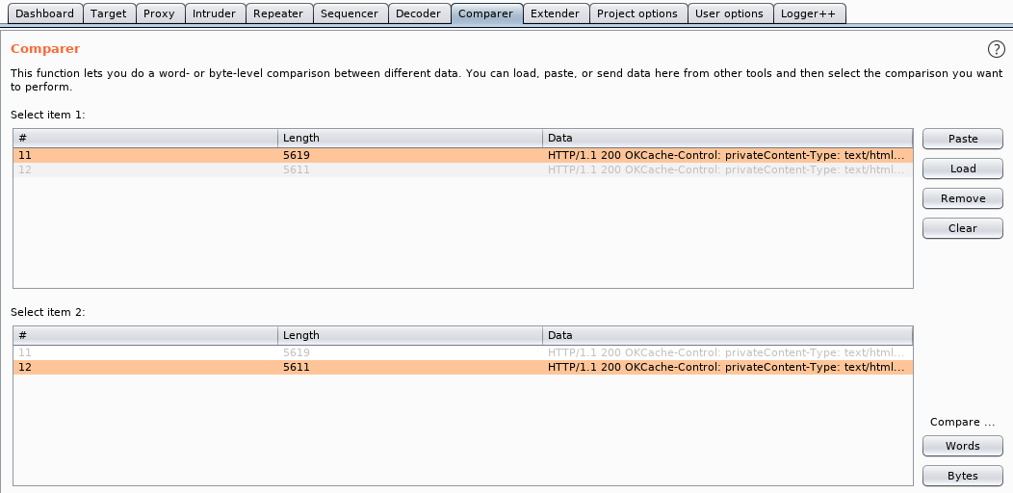
Burp’s core tools - Comparer
Allows you to compare requests/responses side-by-side
Comparer GUI has syntax highlighting to easily spot differences

Slide 58
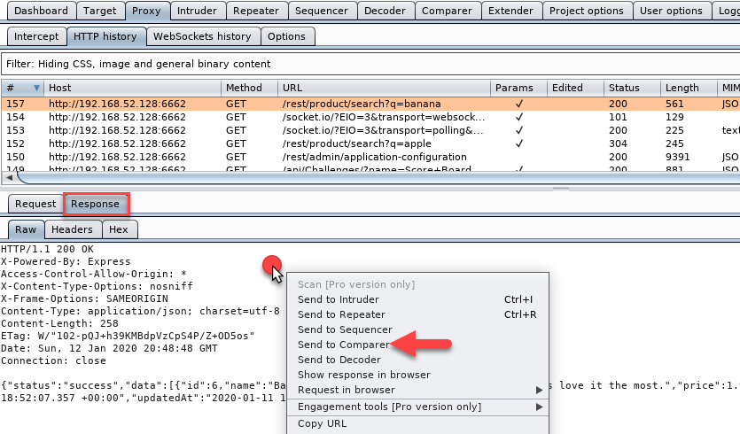
Ex: the HTTP response for the search request for “banana” is sent to Comparer

Slide 59

The response object populates the #1 slot in the list

Slide 60

Response to the search for “orange” is sent to Comparer in slot #2
Item #1 (banana) is selected in the top panel and Item #2 (orange) is selected in the bottom panel

Slide 61

Diff view is shown with highlighted additions/deletions/differences
Using “Sync views” will sync scrolling for larger requests/responses

Slide 62
Burp’s core tools - comparer
How does the ability to compare requests and responses side-by-side help us find web vulnerabilities?
Example: Username Enumeration (sorry, no demo)
Comparing responses between a valid and an invalid username when trying to log in
I’ve seen responses that are identical except for some slightly changed HTML elements that didn’t yield a noticeable visual difference…Comparer allowed me to spot those

Slide 63

Burp’s core tools - Extender
Extender installs Burp extensions to augment existing functionality
You can write extensions yourself, download them from external sources, or install them from the BApp Store (Burp’s official extension community)
Extensions are typically written Java, but Python (Jython required) and Ruby (JRuby required) are also supported

Slide 64

Currently installed extensions are shown under the Extensions tab
Add/remove or enabled/disable extensions from here

Slide 65

BApp Store is Burp’s community of officially supported extensions
Some are only for Burp Pro, but there are many for Community edition

Slide 66

Extensions will usually show up as new tabs and sometimes in context menus

Slide 67
Some extensions that I regularly use:
Additional Scanner Checks (Pro)
Error Message Checks (Pro)
HTML5 Auditor (Pro)
J2EEScan (Pro)
JSON Decoder
Logger++
Python Scripter
Retire.js (Pro)
SAML Raider
Software Version Reporter (Pro)
NetSPI contributions to the BApp store:
AWS Signer – Eric Gruber, Will Strei, Andrey Rainchik
Content Type Converter – Eric Gruber
Java Serial Killer – Eric Gruber
JSON Beautifier – Jake Reynolds
JSWS Parser – Ken Johnson
Token Extractor – Will Strei
Wsdler – Eric Gruber

Slide 68

Final thoughts
Burp is an extremely powerful web application testing tool
We touched on the major functionality, but it has so much more
Start small with Burp, get familiar with the basic tools first
For additional practice, check out PortSwigger’s Web Security Academy: https://portswigger.net/web-security

Slide 69
QUESTIONS?

